Slide 1
An Exploratory Data Analysis and Prediction Model on Layoffs
Guide Name: Dr. Kukatlapalli Pradeep Kumar
Designation :Associate Professor /
Program Coordinator (Data Science)
Team : Aqsam Ahammed – 2062237
Jefin Joy-2062245
Kevin Noronha-2062249

Slide 2
Agenda
Title slide (Title, team details, guide details)
Abstract
Introduction
Problem statements and objectives
Literature review
Design/ Methodology
Implementation and Details
Timeline
Conclusion
References

Slide 3
Abstract
The phenomenon of employee layoffs is a complex and impactful aspect of organizational dynamics that requires thorough examination to understand its implications on various dimensions.
This exploratory data analysis (EDA) aims to provide insights into the patterns, trends, and potential factors associated with layoffs in a diverse set of industries.
The EDA focuses on identifying key indicators that may influence the likelihood and scale of layoffs within organizations.

Slide 4
Problem Statement
Statement: There is a lack of detailed insights into the historical patterns and trends associated with workforce layoffs during economic recessions.
1. Identification of contributing factors:
Factors influencing the occurrence of layoffs within organizations.
Uncertainty regarding the role of workforce demographics, economic indicators, and organizational characteristics in shaping layoff trends.
2. Data-Driven Decision-Making:
Absence of a robust data-driven framework for organizations and policymakers to base strategic decisions related to layoffs.
Limited utilization of statistical and visual analytical techniques to uncover hidden patterns and relationships within layoff data.

Slide 5
Objectives
Analysis with EDA on factors associated with layoffs and other contributing factors.
Designing and Creating a prediction model using AI algorithm.
Creating an extra column identifying the reasons of layoffs, for the prediction model creation

Slide 6
Literature Review
No: | Authors & Year | Title | Source | Gap / Algorithm
1 | Philipp vom Berge, Achim Schmillen.,2023 [1] | Effects of mass layoffs on local employment— evidence from geo-referenced data | Journal:Journal of Economic Geography | The focus is on using robust statistical methods to isolate the causal impact of mass layoffs on local employment.
2 | Matthew A. Kraft.,2022 [2] | The inequitable effects of teacher layoffs: what we know and can do | Journal : Education Finance and Policy | It relies on established statistical methods and a rich dataset to understand the complex dynamics of teacher layoffs.
3 | Min-Hyu Kim,2022 [3] | Framing Effects, Procedural Fairness, and the Nonprofit Managers’ Reactions to Job Layoffs in Response to the Economic Shock of the COVID-19 Crisis | International journal of voluntary and nonprofit organizations | This study used a survey experiment with two factors: Framing Procedural fairness

Slide 7
No: | Author & year | Title | Source | Gap / Algorithms
4. | Shibata, Mr Ippei, 2020. [4] | The distributional impact of recessions: the global financial crisis and the pandemic recession. | Research paper on International Monetary Fund | The main focus of the paper is to understand the distributional impact of the two recessions, meaning how they affected different groups of workers differently.
5. | Singh, Manjeet 2021 [5] | impact of global recession on the economy of developing countries. | International journal of economic perspectives | Methods used : Econometric modelling Comparative analysis Statistical analysis
6. | Rahmatillah, Sri Fatimah, 2023 [6] | Problems of the Global Economic Recession and Strategies for Facing It: An Islamic Economic Perspective | Journal of Sharia Economics & Islamic Business | it focuses on applying Islamic economic principles and frameworks to understand and address the problems of the global economic recession.
7. | Humaid, Ali Abdalla, Al Jari, and Mohamad Zahir Zainudin, 2024 [7] | Causative Factors Of Youth Unemployment Impacted From Global Economic Crisis. | Tropical Scientific Journal | Algorithms used: Statistical algorithms Text analysis algorithms Causal inference algorithms

Slide 8
Literature Review
No: | Authors & year | Title | Source | Gap / Algorithm
8. | E. Sathya Priya,2023 [8] | Study on Global Recession of Import and Export in India | International Journal of Multidisciplinary Research Transactions | The findings may not be generalizable to all organizational contexts, as different company cultures and structures can influence employee relationships and layoff decisions.
9. | Hou-Tsan Chang, Hui-Ju Wu,2009 [9] | Mining Organizational Networks for Layoff Prediction Model Construction | 2009 International Conference on Advances in Social Network Analysis and Mining | Algorithms used: Community detection algorithms Centrality measure
10. | Fleming, Padraic 2022. [10] | A case study of workforce trends in Ireland. | Human resources and health | Job losses: The Great Recession and COVID-19 led to workforce reductions in healthcare.

Slide 9
1. Effects of mass layoffs on local employment— evidence from geo-referenced data
The study analyzes the impact of mass layoffs on municipal-level employment using geo-referenced data.
The study highlights the importance of considering the size of the mass layoffs and the characteristics of the affected municipalities in understanding the mechanisms underlying the direct and indirect effects of mass layoffs on local employment.
The findings have implications for policymakers and local communities affected by mass layoffs.
Approximately a quarter of the employment loss that occurs within the first year following mass layoffs is absorbed or mitigated within the same municipality. This implies that the negative consequences of job losses are somewhat counteracted locally.

Slide 10
2.The inequitable effects of teacher layoffs: what we know and can do
Provides valuable insights into the consequences of teacher layoffs and offers policy recommendations to address the inequitable impact of economic downturns on public education.
The Great Recession led to significant teacher layoffs, resulting in negative consequences for student achievement and exacerbating educational inequality.
The study suggests to explore alternative ways to reduce personnel expenditures at the district level, such as early retirement incentives and collective action, to minimize the need for layoffs.
It emphasizes the importance of policy interventions at the federal, state, and district levels to address the inequitable effects of teacher layoffs and protect the educational opportunities of vulnerable students.

Slide 11
3.Framing Effects, Procedural Fairness, and the Nonprofit Managers’ Reactions to Job Layoffs in Response to the Economic Shock of the COVID-19 Crisis
The study shows that trust and support of nonprofit managers for their organizations are more influenced by procedural fairness than the favorability of outcomes.
When procedural fairness is low, nonprofit managers respond very favorably to keep conditions and very negatively to layoff conditions. This highlights the importance of fair processes in decision-making within nonprofit organizations
Nonprofit organizations face increased demands for services alongside decreased revenues, leading to tough decisions
The findings suggest that nonprofit managers should receive training to apply organizational policies consistently and equitably, particularly during times of crisis

Slide 12
4. Mining Organizational Networks for Layoff Prediction Model Construction of 2009
The study aims to predict layoffs using data mining techniques on organizational networks, employing clustering, association rule generation, and decision tree algorithms.
Network structure analysis is crucial, considering indicators like density, degree, centrality, and position analysis to understand communication patterns.
The WEKA tool is used for association rule generation, resulting in eight useful rules related to laid-off employees' attributes.
References to literature include works on data mining and social networks.
Layoff association rules are generated using WEKA, providing insights into employees' patterns in given data sets.

Slide 13
5.The Distributional Impact of Recessions: the Global Financial Crisis and the Pandemic Recession
GFC & Pandemic Recession disproportionately harmed young, less educated, female, and Hispanic workers.
Low-income earners faced greater job losses compared to high earners in both recessions.
Pandemic Recession saw more temporary layoffs.
Teleworkable jobs fared better, while social jobs experienced larger employment declines.
Both recessions significantly widened income inequality.

Slide 14
Requirements
Software requirements
Google Collab (python 3.10)
Microsoft Excel (2018)
Hardware requirements
Microsoft Server 2008 R2 or newer.
Intel Pentium 4 or AMD Opteron processor or newer.
2 GB memory.
1.5 GB minimum free disk space.

Slide 15
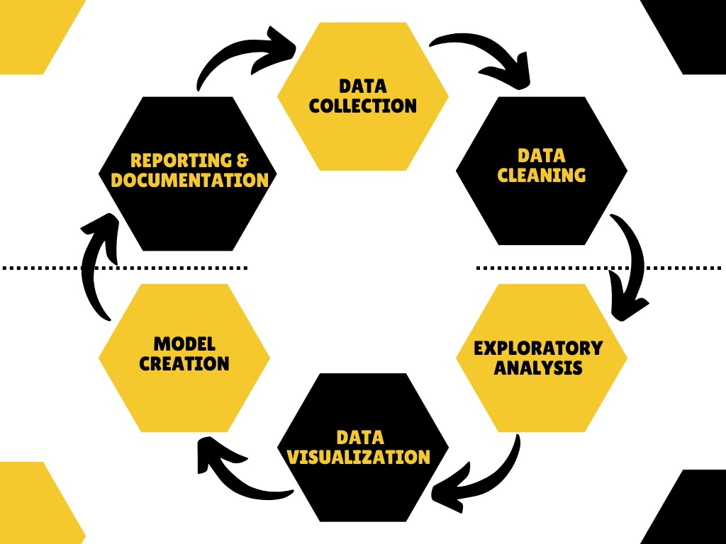
Design and Framework

Slide 16
Flowchart
Data Collection
Data Pre- Processing
Splitting the Dataset
Model
Deployment
Model Evaluation
Model Training

Slide 17
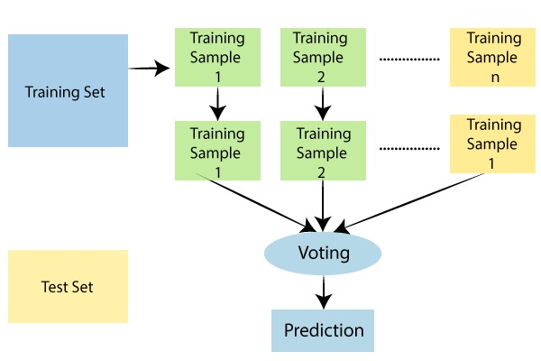
Framework of Random forest

Slide 18
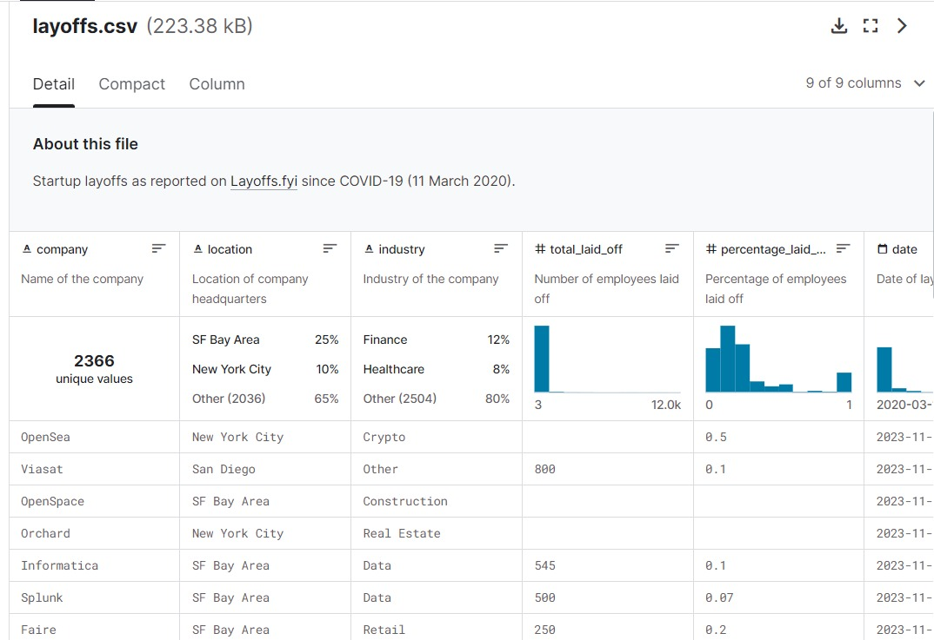
Dataset Screenshot

Slide 19
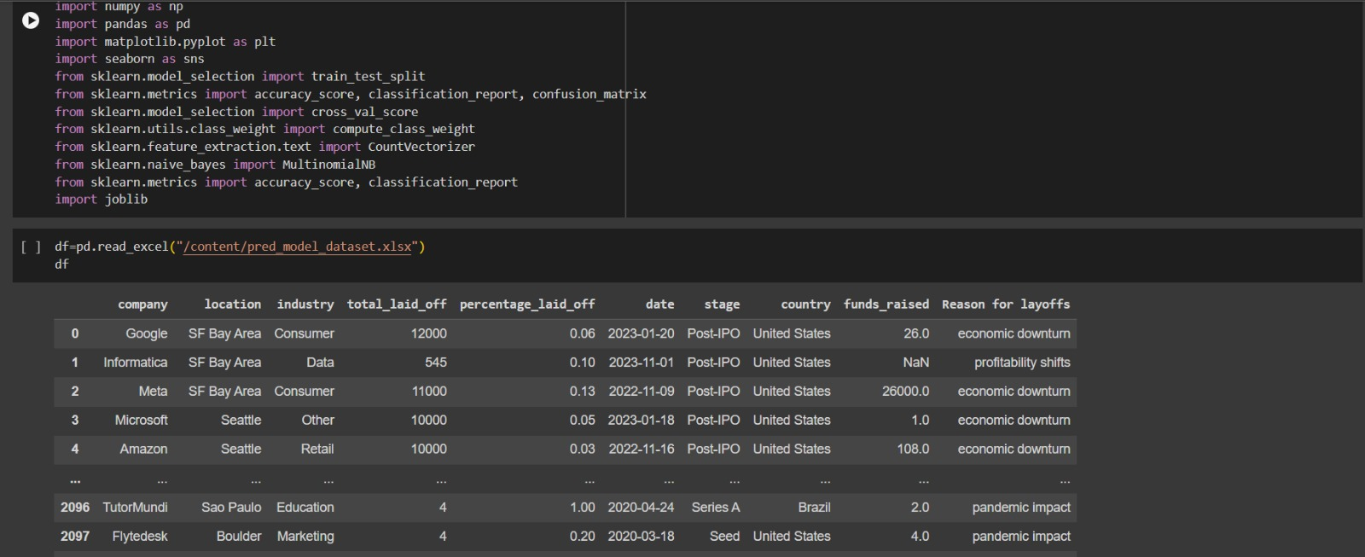
Implementation and Results

Slide 20
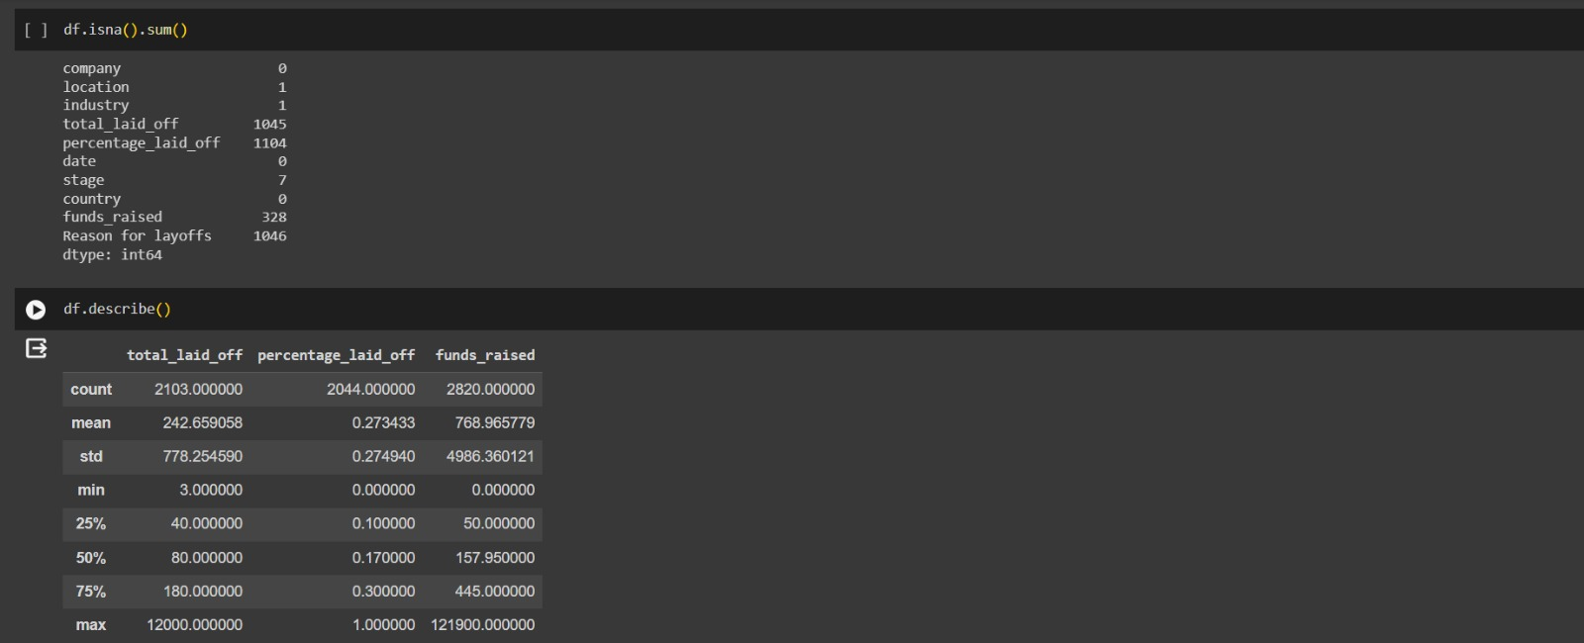

Slide 21
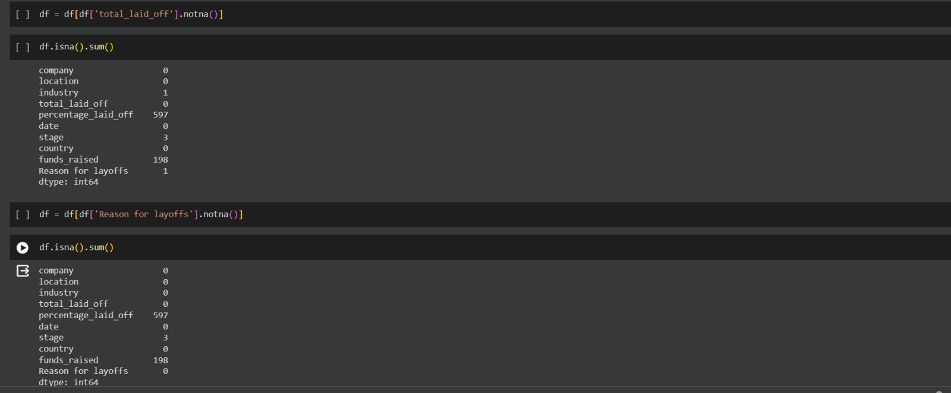

Slide 22
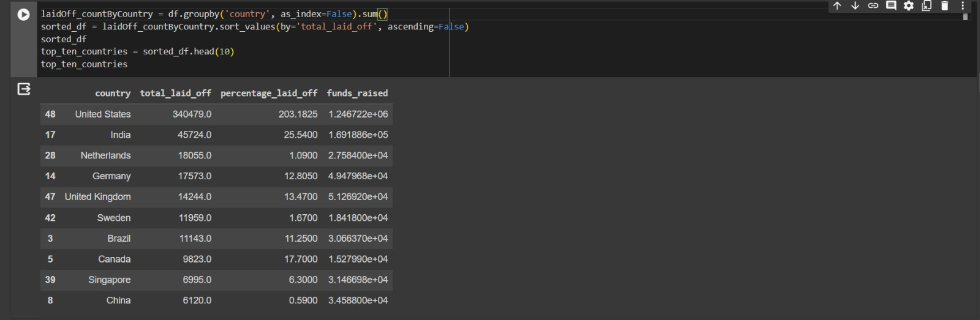

Slide 23
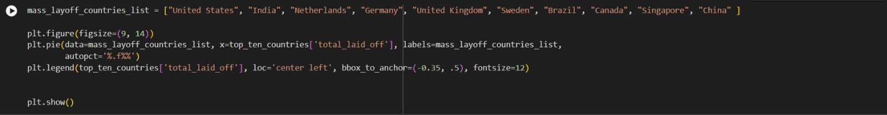
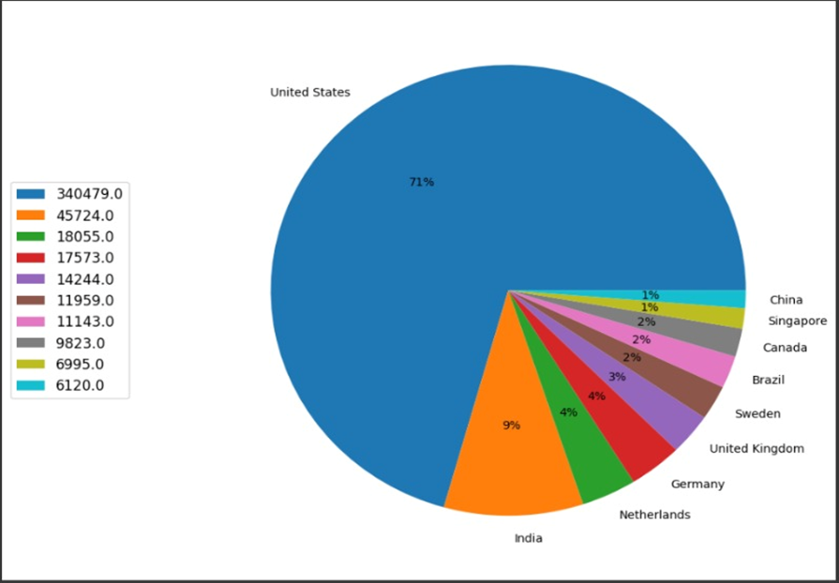

Slide 24
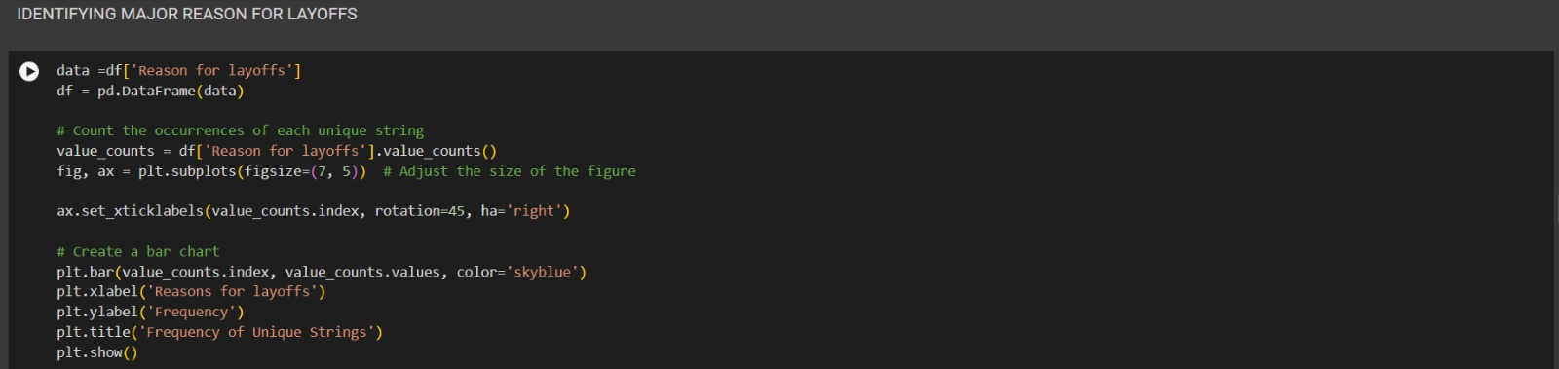
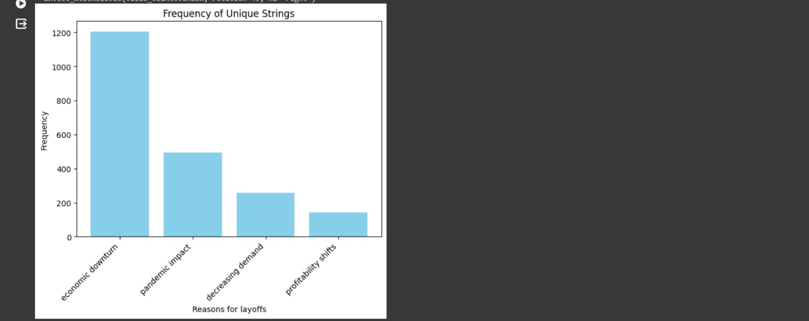

Slide 25
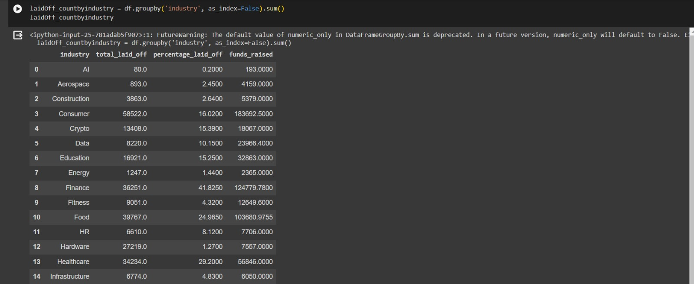

Slide 26
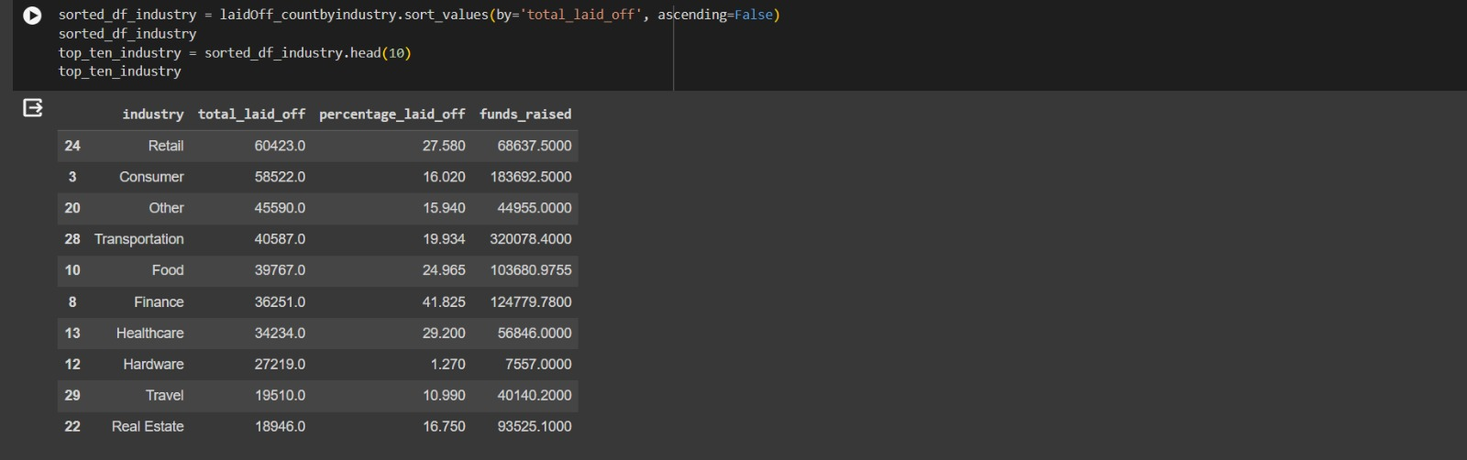
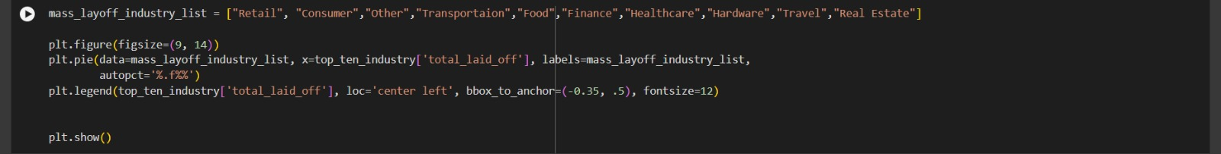

Slide 27
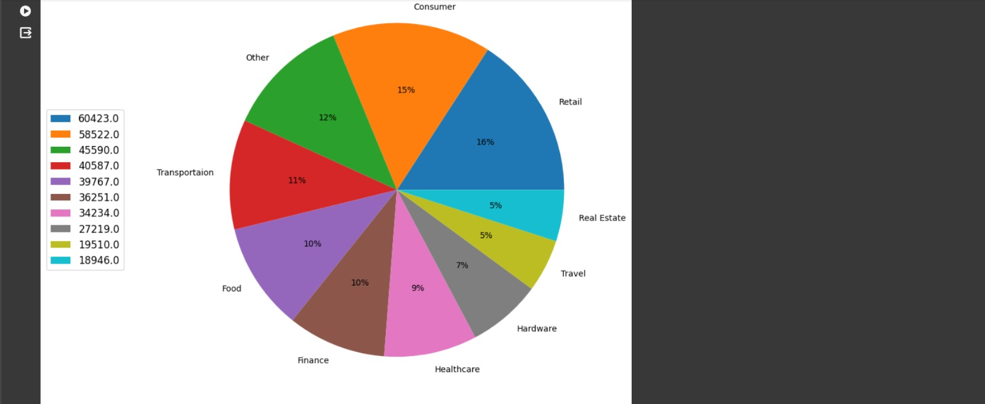

Slide 28
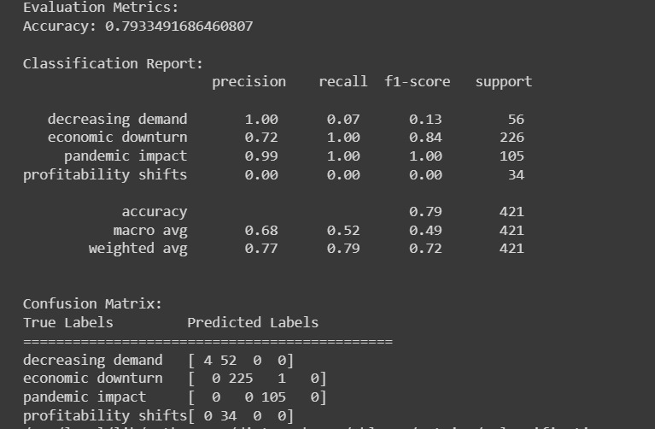
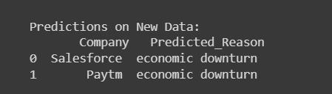

Slide 29
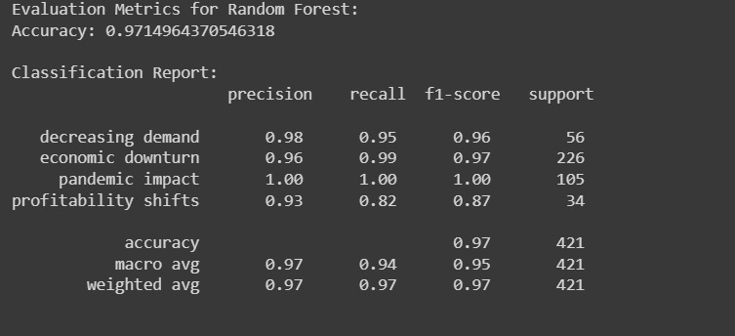
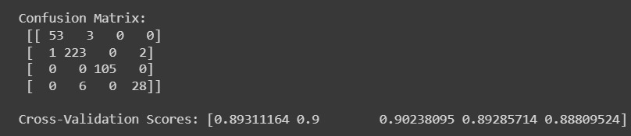
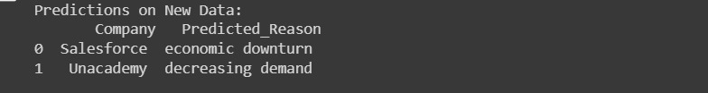

Slide 30
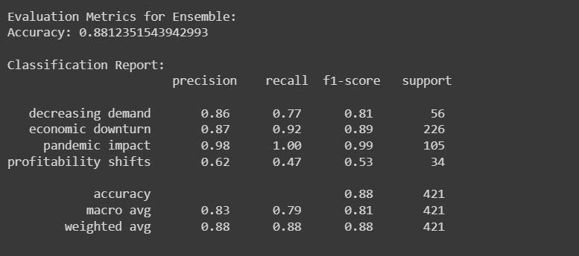
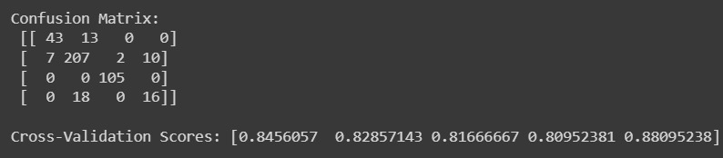
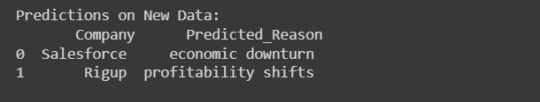

Slide 31
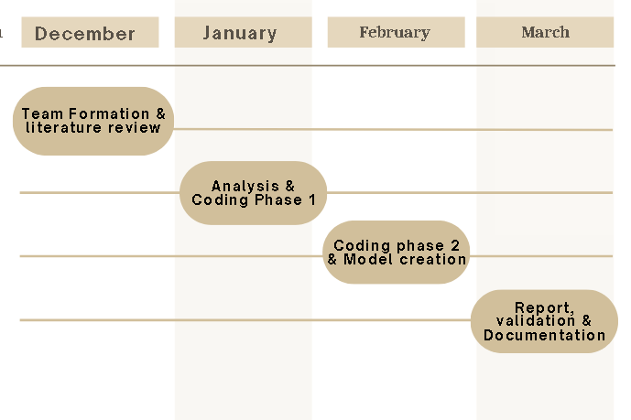
Timeline

Slide 32
Conclusion
Exploratory Data Analysis (EDA) on layoffs involves delving into various factors contributing to employee layoffs within a dataset, including demographics, performance metrics, economic indicators, and company-specific variables. Through EDA, patterns and correlations within the data are identified, providing insights into the underlying dynamics of layoffs. Following EDA, the development of a prediction model for layoffs was done using machine learning algorithms like naive bayes and random forest. Model performance is evaluated using metrics such as accuracy, precision, and recall. Among the three models that was created, niave bayes initally showed a 79% accuracy. After some optimizations , we were able to increase its accuracy to 81%. Among the three models that were created , we found random forest to provide the best results. Additionally, feature importance analysis helps to understand the relative influence of different factors on layoff predictions. By combining EDA with predictive modeling, organizations can gain a deeper understanding of layoff trends and potential risk factors, enabling proactive measures to mitigate the impact of workforce reductions and optimize workforce management strategies.

Slide 33
References
Vom Berge, Philipp, and Achim Schmillen. "Effects of mass layoffs on local employment—evidence from geo-referenced data." Journal of Economic Geography 23.3 (2023): 509-539.
Kraft, Matthew A., and Joshua F. Bleiberg. "The inequitable effects of teacher layoffs: What we know and can do." Education Finance and Policy 17.2 (2022): 367-377.
Kim, Min-Hyu. "Framing Effects, Procedural Fairness, and the Nonprofit Managers’ Reactions to Job Layoffs in Response to the Economic Shock of the COVID-19 Crisis." Voluntas: International Journal of Voluntary and Nonprofit Organizations 33.5 (2022): 1035-1050.

Slide 34
References
H. -T. Chang, H. -J. Wu and I. -H. Ting, "Mining Organizational Networks for Layoff Prediction Model Construction," 2009 International Conference on Advances in Social Network Analysis and Mining, Athens, Greece, 2009, pp. 411-416, doi: 10.1109/ASONAM.2009.52.
Priya, Ms E. Sathya. "Study on Global Recession of Import and Export in India.
Avagianou, Athina, et al. "Being NEET in youthspaces of the EU South: A post-recession regional perspective." Young 30.5 (2022): 425-454.
Aswathanarayana, K. "IMPACT OF COVID-19 ON INDIAN ECONOMY AND GLOBAL RECESSION." EPRA International Journal of Economics, Business and Management Studies (EBMS) 9.5 (2022): 85-87.
.

Slide 35
References
Bennett, Jacks, et al. "Investigating Change in Student Financial Stress at a UK University: Multi-Year Survey Analysis across a Global Pandemic and Recession." Education Sciences 13.12 (2023): 1175.
Fleming, Padraic, et al. "Implications for health system reform, workforce recovery and rebuilding in the context of the Great Recession and COVID-19: a case study of workforce trends in Ireland 2008–2021." Human Resources for Health 20.1 (2022): 1-11.
Coile, Courtney C., and Phillip B. Levine. "The market crash and mass layoffs: How the current economic crisis may affect retirement." The BE Journal of Economic Analysis & Policy 11.1 (2011).

Slide 36
References
Verick, Sher, and Iyanatul Islam. "The great recession of 2008-2009: causes, consequences and policy responses." (2010).
Lin-Sperry, Ember. "Covid19 Recession: Gender Layoff Gap Explodes." Berkeley, CA: University of California.[Google Scholar] (2021).

